Slide 1
Aide_chipbuilder – design infra
DMAI FE- Chin Yin, Eric Olson, wplim, lionel, etc

Slide 2
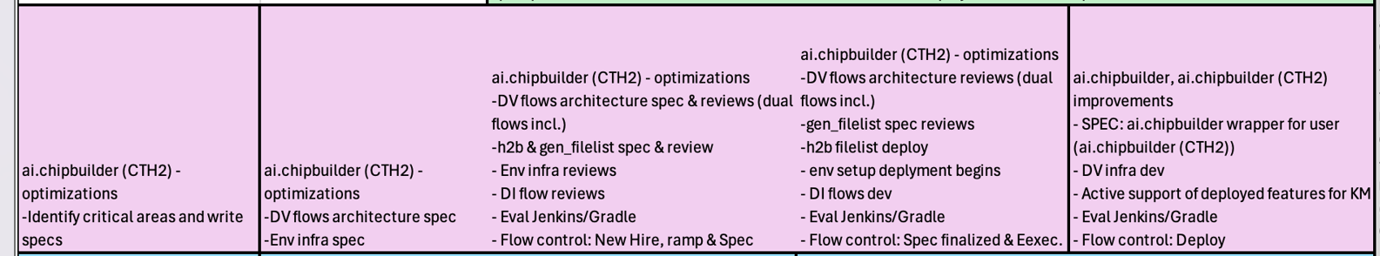
Chipbuilder Scope and schedule

Slide 3
AIDA Framework
Compliancy Check (0.8, 1.0)
Central Run (Compliancy of Every Drop) – LEC, SDC …
aida framework
Official Drop
ai.dash + ai.drop_box
DMX + syncpoint
adm command Interface
Dashboard
Central Run
Central Build
Central Release
GK Nightly
(mysql/ici) + Metric (R2G + IPDE)
Central Database
Data Repository
Package Run
Git Hub
(FE-da)
Proj Archive (BE-DE)
Turnin
(FE)
CFA
(BE-IPDE)
P4
(BE-da)
Local Git (FE- DE)
Flow Engine
iflow
(FE)
Smake
(BE-IPDE)
Flow Tracer
(BE-ASIC)

Slide 4
DA Dashboards Framework
AIDA Framework
(DevOps on GitHub)
ai.dash
(RTL Quality metrics and dashboard)
TFM
Analytics
ai.ChipBuilder
ai.drop_box
Central Runs
Checklist & Signoff
Silicon Debug
Under
construction
SPEC Ready, not yet under construction
Yet to be spec-ed

Slide 5
Chip Builder FE designer workflow
99% the same as KM
user commands | under the hood
git clone $GIT_REPOS (or cd to existing repo) | Git revision control with NFS origin
cb_setup (or setenv $WORKAREA `pwd`) | Set initial cb paths and core env vars
make help, make clean | Iflow generated makefile with inventory/utility
make –j <task> | Make rule for task. Runs in cb-config environment (dynamic git repo controlled, NOT shell env)
make –j <task> ARC=zzzz | Makefile using (blocking) arc-submit for lsf/?
make cmds_<task> (cd <flow>; make flow_cmd) | FE rtl flow manual run (dynamic cb-config env)
turnin (-mock, -local, etc) | Runs cb-gk and pushes commits to repo, releases
AI-dash – runs as before | AI-dash looks at release data (and other data)
cb-configuration will resemble and behave as km: tool.cfg, flow.cfg, design.cfg, etc
DA provides baseline updates as in km (separate baselines for tools, proj, dv, etc?)

Slide 6
FE configurations (tool, flow, & design) common syntax/tool (cb-infra) for git repo-based settings
Multiple types of configurations:
tool config (env vars, tool versions, parameters, licenses) - arc resources, tool setup.
flow config (flow setup/options for designers) - flow/variant parameters. May override tool config)
design config (a per-dut definition of design parameters) May also override tool/flow parameters with user’s customization
Other configs possible (iflow config, regression config, cell config)
Multiple usage modes:
Python API/Rest API – used inside flows/scripts to get/setup information
Shell – create tool-specific shells with sourced environment
Wrapper – run versions of scripts within a dynamically created local environment (not shell)
Command line query – debug info, trace origins of configuration data, diff environments, enforce minimum environments, generate configuration patches.
Multiple configuration sources:
Defined versions – globally defined & labeled sets of configurations
$WORKAREA/file-based – versions are defined by configuration files (revision controlled)
Priority-based overrides (for example: tool, baseline, project, repo).
Notes:
Light infra + arc shell – allow version checking, syntax checking etc , resolve any short coming of lite infra. Main flow okay, but flows that include common files ( under DEFINE) – pain to include in the right way, putting syntax checks. Rather using includes. We do a baseline check with version release.

Slide 7
New baseline
The format for a tool.cfg will be backward compatible with the existing tool.cth It will likely be identical. It is only down in the da tool definition that we will get use the 'arc api' to grab configuration data.
The configuration will still control what version, arc just gives you the ENV variables you need for that version. -- all that is hidden from the user.
flow.cfg and design.cfg will be identical or enhanced. (arc does not help here). Our baselines will pretty much look the same. We need all that data that defines how the flows should run.
Will baseline cover for DV? To be discussed further.
Baseline for BE – to be discussed further.

Slide 8
Arc shell
Arc used for job submission environment (utilizing cb-infra as needed)
Arc can define versioned resource sets and their dependencies
environment, paths, licenses
cb-configuration determines which versions of arc resources get applied to each flow
Cb-infra handles version overrides, (arc resource sourced using 'delayed evaluation')
Conflicts and dependencies are checked and correctly resolved – within multiple resources or between resources and native db-configuration variables
Some of the comparison arc and cheetah
https://altera-corp.atlassian.net/wiki/spaces/tdmaInfra/pages/396984755/038+Comparison+of+ARC+CHEET…

Slide 9
ai.ChipBuilder [Gatekeeper] - Lionel
Why We Need To Do This
We need to move away from PESG code
Changes in base infrastructure (eg: job submitsson, environment setups, etc …)
Plan
To only refactor the underlying mechanism, by retaining as much as possible the user-interfacing layer, so as not to disrupt any existing workflow.
Reality
Should be doable. Even if required, we would want to minimize the impact on flow-owners' changes as much as possible.
Impact To Users
Flow Owners: Transparent to minimal change required.
Designers: Transparent. Should still run the same `turnin` command to get a release.

Slide 10
ai.ChipBuilder [Code Review In CI/CD]
Gatekeeper is a CI/CD
Code Review is a blocking process, which we do not want it to GATE a reltag (at least in Altera's work environment)
Having said that, there is still a way to incorperate code-reviewing process in a CI/CD environment which should work in Altera's environment.
That is, by treating code-review as a STAGE in the CI/CD process.

Slide 11
ai.ChipBuilder [Code Review In CI/CD] - con't
Step 1: Coder:
give Reviewer the path to his $workarea
Step 2: Reviewer:
git clone <coder's $workarea>
cd $workarea/code-review
make run_code_review
# do code review, approve/disapprove, etc ….
logs/trails generated by the code-review tool
Audit file generate by run_code_review
git add/commit
give Coder his workarea
Step 3: Coder:
git fetch/merge <reviewer's workarea>
# fix code, send back to Reviewer.
# Iterates (Step 2 – Step 3) , until Reviewer approves.
git fetch/merge <reviewer's workarea>
turnin
*(All the steps above should be automated into cmdline tool)
Audit File
[approver] wplim
[files] src/rtl/a.v 123abcf45sf13 src/rtl/b.v 947798fdbca12

Slide 12
ai.ChipBuilder [Code Review In CI/CD] - con't
During Turnin
make code_review_check
Validates approver exists
Validates checksum correct
Audit File
[approver] wplim
[files] src/rtl/a.v 123abcf45sf13 src/rtl/b.v 947798fdbca12

Slide 13
ai.ChipBuilder [Code Review In CI/CD] - con't
Never gates/disrupt the CI/CD Flow
IP owners has choice to turn on/off code-review in iflow_gui, eg:-
bypass_8__code_review_checker – turnin – Gating
bypass_8__code_review_checker – release – Non-Gating
All the code-review trails/logs/etc are checked-in/released together.

Slide 14
ai.ChipBuilder [arc_prime] - Lionel
Why We Need To Do This
We need to move away from PESG code
Changes in base infrastructure (eg: job submission, environment setups, etc …)
Plan
To only refactor the underlying mechanism, by retaining as much as possible the user-interfacing layer, so as not to disrupt any existing workflow.
Reality
Should be doable. Even if required, we would want to minimize the impact on flow-owners' changes as much as possible.
Impact To Users
Owners of [archie/eouMGR]: Transparent to minimal change required.
Designers: Transparent. Should still run the same `arc.pl` command to put/get data.

Slide 15
Job submission
Currently using netbatch
Proposal from compute infra ( Steve Slany)
LSF learning to be planned. To compare being Altair vs IBM solution.
Update: Windows NB-> LSF issues (impact SAS), linux version once installed will need to be tested. Early testing towards the end of the yr, broader usage in 2026
Migration to LSF – https://altera-corp.atlassian.net/wiki/spaces/tdmaInfra/pages/293801528/Netbatch2LSF+CLI+Project Evaluation collaboration with IBM. Jo Wei & Jeff U will work with Altair to setup eval env. Clarification on supported vendors, some are not listed -> concern for testing
[ww39] Decision end of 2025. Currently in discussion phase.
Lsf ( converter from netbatch to LSF) Lionel with work Steve Slany
GK will generate nbtaskfile
There will be a converter to convert the current job submission to the next gen of job submission
Mostly flows are under this case
Except for flow submit with netbatch run ( flow owner to check on this)
10nm using arc submit :
Arc submit will be handle transition of the job submission tools
If the tool is doing extra reading of the output of the log file generated by netbatch, the tool owner need to do special work here. ( AR: all DMAI Tool owner to take care)
Ex: DMX release will need special handling
BE: arc.pl command …

Slide 16
ai.ChipBuilder (NextGen Design System Details)
 | Current | AIDA Chipbuilder | Owner
CB-infra | Cheetah with light infra | Common configuration tool with cth compatible overrides. Native arc shell resource support. For tools, flows, & design | Eric/wplim
Flow | Iflow( FE)/IPDE ( smake)/R2G ( FT) | Iflow( FE)/gradle? [make, gk, lsf, etc] IPDE ( smake) R2G ( FT) ? | FE/BE flows owners
Job submission | netbatch | LSF or altair | Steve Slany and LIonel
Database mgt | Turnin/GK( FE) –Prog_archive ( BE) | FE: Turnin/GK? - GITHub( Q1) Any other options now? Jenkins? | Lionel
CB-baseline_tools | Cheetah baseline | New baseline ( KM like) | Eric
Filelist and netlist |  |  | Giang
CB-rtl | Cheetah - RTL | Our own flows … CB tools, We should start with a clean methodology, nice API, clear documentation, and rules. We should have a unit test for each flow that verifies the rules. (so everyone think about how to do that before the next meeting) | Flow owners
Release and audit | Dmx audit | Dmx audit | Lionel

Slide 17
Back UP

Slide 18
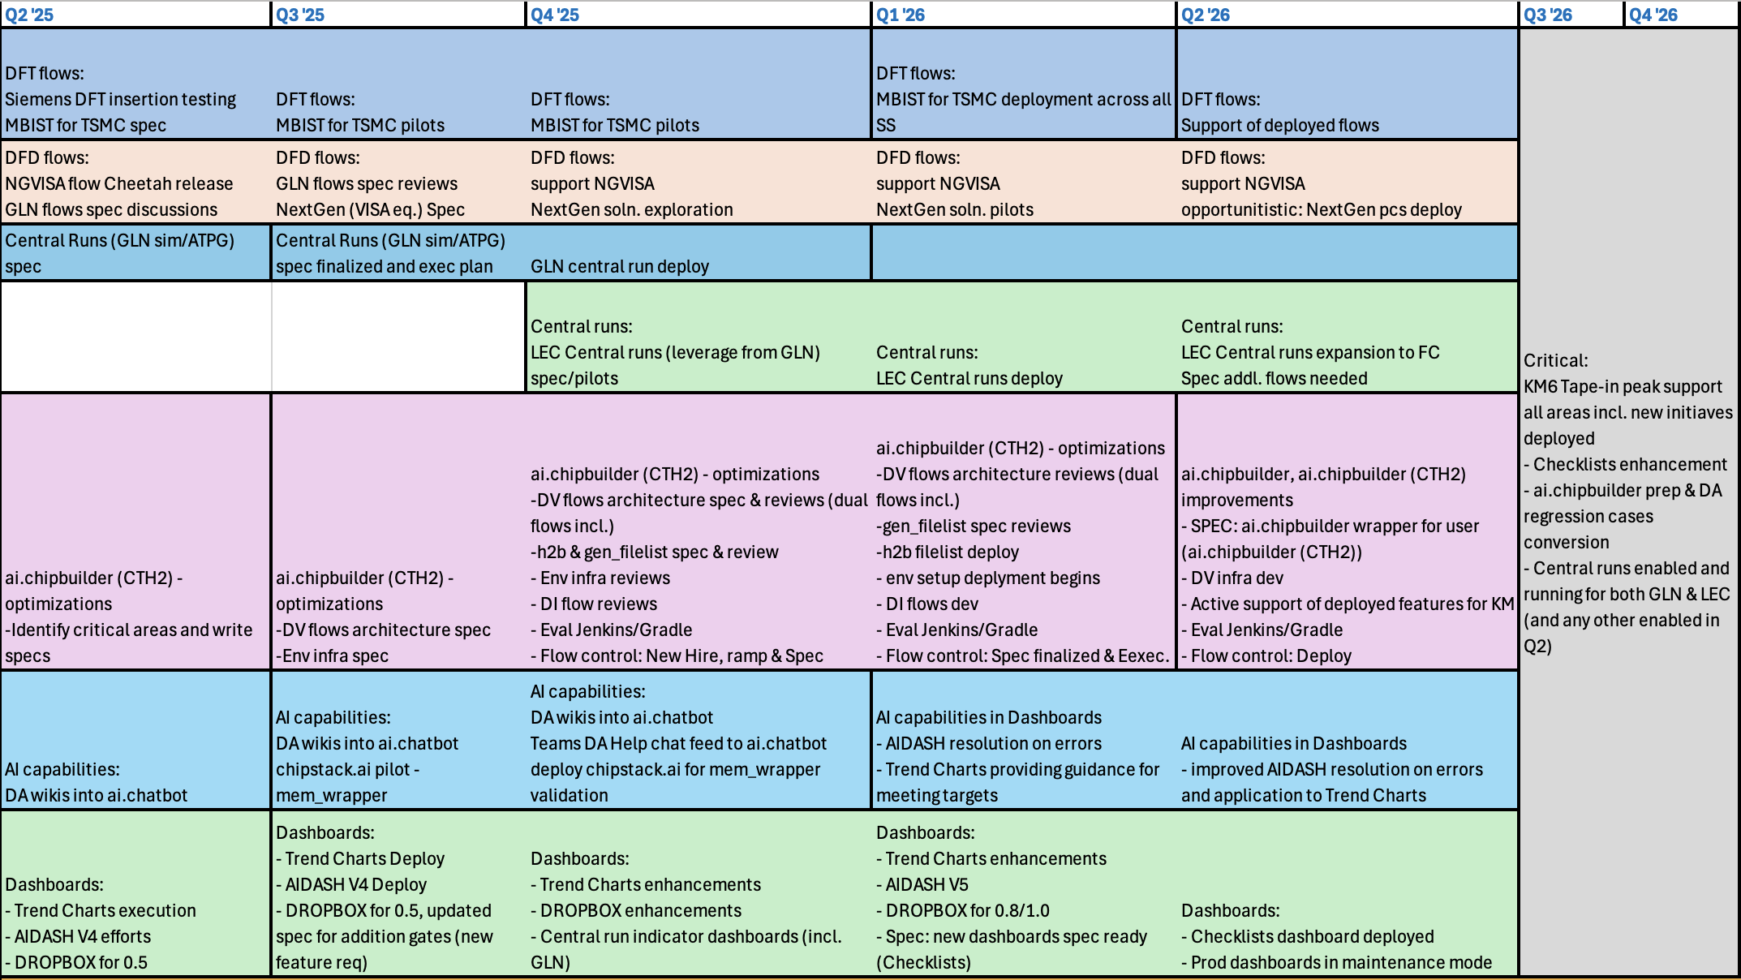

Slide 19
Automation and Efficiency improvement initiatives
Current initiatives
wrap_gen
GLN
cfgip
iflow_gui
Synthesis menu
FCC
fe_netlist_chk
Budget soln.
CTF
Drop tracking & Dashboards
ai.dash
ai.drop_box
ai.trends
Future initiatives
Code Review tools
slang to replace verific
MemoCAT
Auto uprev baseline_tools
CRUISE
ai.ChipBuilder (NextGen Design System)
CB-infra
CB-baseline_tools
CB-rtl
Filelist generation and organization
DFT/DFD
utilities
Multivendor – TetraMax vs. Tessent

Slide 20
ai.ChipBuilder [CB-Infra] Eric Olson
Problem statement/efficiency gain: Brand new design system setup infrastructure tailored for Altera design development
Timeline: Brainstorming (Q4 ‘25), TR and Execution (starting Q1 ‘26)
Progress: Ideas exchange
Plans/Ideas:
CB-infra - configuration system to replace liteinfra in frontend, backend, dv
same api as liteinfra, so replacement is easy. Use for env config, tool version config, flow config, dut config, etc.
Arc resource integration
support overrides & partitioning (liteinfra) and dependencies (arc) together. Read .ini/.cth/arc with additional features.
Provide shells, wrappers, and tool-api
Add traceability, diff, compliance tools.
Collaborators: DMAI FE team, Jeff Willey
Feedback & Next steps

Slide 21
CB-infra: more details
CB-infra - configuration system to replace liteinfra in frontend, backend, dv
same api as liteinfra, so replacement is easy. Use for env config, tool version config, flow config, dut config, etc.
Arc resource integration
support overrides & partitioning (liteinfra) and dependencies (arc) together. Read .ini/.cth/arc with additional features.
Provide shells, wrappers, and tool-api
Add traceability, diff, compliance tools.
cb-infra is a configuration layer over arc resources to handle the more general configuration need of the frontend.
The syntax and compatibility make cb-infra useful for frontend, backend, dv, and sw design flows.
cb-infra syntax is ini/toml format with !includes (backward compatable with .cth)
Redefinition of keys results in overrides. Use of overridden values use delayed evaluation, even if those values are used in arc resource names or in include path (possibly needing another pass)
Syntax is extended for better control of overrides, dependencies, and conflict resolution:
Value/version checking (>=, ==,~=,~!)
Value manipulation (=?, :=, +=, -=, s///)
Comments/line directives for tracing the origin of configuration values and explaining meaning

Slide 22
ai.ChipBuilder [CB-baseline_tools] Eric Olson
Problem statement/efficiency gain: Brand new design system Tool Bundle infrastructure tailored for Altera design development
Timeline: Brainstorming (Q4 ‘25), TR and Execution (starting Q1 ‘26)
Progress: Ideas exchange
Plans/Ideas:
CB-baseline_tools - core tools baseline tools (no default technology, but it may enable in a parameterized way)
non-project release cadence. I am thinking fairly frequently
Replacement for PESG baseline_tools, but we will pull most of our Altera baseline_tools into here.
<proj>-baseline-tools - project part of baseline_tools. One per project.
Project/milestone determined releases.
Replacement for current altera baseline_tools (included by project repos)
contains: project data, reference CB-baseline-tools, project tool overrides.
Need a example/seed design repo. Maybe one for each project? (or a branch for each project)
This can probably be shared between frontend and backend (backend creates a local-only git repo but not stored in $GIT_REPOS)
Have a single, simple sync command that:
syncs frontend repos to correct baseline & adds any new flows. No merging is ever necessary.
can sync backend updates to backend workareas/wards as needed for their releases.
Collaborators: DMAI FE team, Jeff Willey
Feedback & Next steps

Slide 23
Next generation prog_config.cth ( new name? prog_config.cb)
Standardize the global level, flow level, collaborate with BE in calling some same env/tools versions, design infra related versions etc.
Better organizer the wrappers among the different config ( hierarchical inclusion of things)
No cheetah light infra
Prepare of unified project bundle calling ( like arc shell or even an new evolution of cheetah, but a rename to altera name )
[Includes]
#/p/psg/da/infra/admin/cth2/psg/rc/ALL_FETOOLS.cth
#/p/psg/da/infra/admin/cth2/psg/rc/bu_ovr/km5_hw_fe.cth
/p/cth/cad/altera_techdirs/km_0.06/tool.cth ( individual arc shell)
/p/psg/EIP/intel/ip/ip_tag/KM_T_0.3/ip_tag_tool.cth ( individual arc shell)
#psg_vclp_utils version include here to setup the env variable
/p/hdk/pu_tu/prd/psg_vclp_utils/25.16.002/tool.cth ( individual arc shell)
$WORKAREA/baseline_tools/proj_config/PSG_fe.cth
$WORKAREA/baseline_tools/ctech/ctech_n3p_h169p48.cth
Flow/tool.cth
Env include should be in the same .cth, and don’t get from other area.
Cheetah make: lazy evaluations, get everything everywhere. ( using includes)

Slide 24
ai.ChipBuilder [RTL flows structure, CB-rtl] Eric Olson
Problem statement/efficiency gain: Brand new design system Tool Bundle infrastructure tailored for Altera design development
Timeline: Brainstorming (Q4 ‘25), TR and Execution (starting Q1 ‘26)
Progress: Ideas exchange
Plans/Ideas:
CB-rtl - library of frontend tools. Makefile driven, using flow config
Individually transition from Intel-owned flows. (because we retain API)
May move baseline_tool customizations into actual tool flow
Migrate some custom tool here
Key problems to solve
How do we minimize issues/support with releases?
How best to inherit/include standard settings into individual repos
Minimal updates need for transitioning from Cheetah-RTL to CB-rtl
Collaborators: DMAI FE team, Jeff Willey
Feedback & Next steps

Slide 25
iflow/iflow-gui - task/build management Eric Olson
Problem statement/efficiency gain: Improved flow management. Ease of use capabilities
Timeline: actively used
Progress: support. #1 issue is explanation of behavior, so I want to add traceability features
Collaborators: build steps distributed among flow owners
Long term plans
add features to support LSF building when needed
usability features to gui
move traceability features for .ini files to a general library (for liteinfra/cb-infra configuration files)
Ready to fill in any gaps if gatekeeper has issues post-intel
Feedback & Next steps
Notes:
Was about 15% time past few months: Support, bug fixes, minor features

Slide 26
ChipBUilder- RTL
CB-rtl - library of frontend tools. Makefile driven, using flow config
Individually transition from Intel-owned flows. (because we retain API)
May move baseline_tool customizations into actual tool flow
Migrate some custom tool here
Key problems to solve
How do we minimize issues/support with releases?
How best to inherit/include standard settings into individual repos
Minimal updates need for transitioning from Cheetah-RTL to CB-rtl

Slide 27
Filelist generation Giang Nguyen
Problem statement/efficiency gain: Help to eliminate challenges with current methodology
Workarounds for SV packages dependencies (soft IPs listed in hard IP list), hierarchical HIPs (sub-IPs of HIPs need to be in HIP list)
Reduce GK run time (by eliminates current extra flows: adjust_hip, udm_genfilelist, flat_genfilelist, stub_genfilelist, etc)
Timeline: Brainstorming (Q2 '25), TR and Execution (starting Q1 ‘26)
Progress: idea exchange
Plans/Ideas:
"One-stop shop" filelist generation to generate everything necessary (filelists for multi-stage, flat, UDM, stub, synthesis, sim, power estimation, collaterals for BE
Adjust rules/formats to eliminate current challenges/restrictions
Collaborators: FE DMAI
Feedback & Next steps

